Slide 1
ENSE 374, Milestone 1
UR XTech
Kaden Goski
Julio Andrés Silva Vásquez
PAul Wangwe
October 2nd 2019

Slide 2
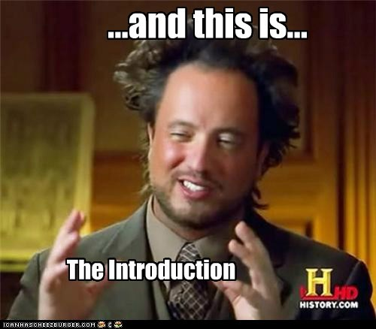
Team introductions
We are UR XTech
https://github.com/alpacamusical/Project-ENSE-374

Slide 3
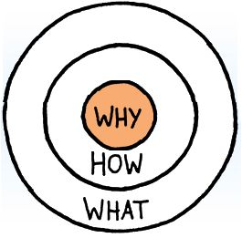
Elevator pitch
Our Golden Circle
“Why”: To make it simpler and easier to review/ find new movies.
“How”: With our development team and resources from the U of R.
“What”: An application to review movies.

Slide 4
Initial system & functional requirements
What exactly are we doing?
An application to review movies but simpler than IMDB or Fandango with an scrumish methodology.
What gap are we trying to fill?
As stated above, a simpler way to review movies and view various new ones.
Project vision
A java application
Project rationale
We believe that the existing movie review options have implemented too much clutter to their designs.
Envisioned stakeholders
Users who want a clean and simple move review application with no advertisements or paparazzi clutter.
Discuss assumptions
This application must have at least the newest movies in its database, some type of review system.
It has to be simple and to the point.

Slide 5
Functional ReQuirements
Allow the user to watch trailers of movies
Allow the user to sign in and post reviews
Recommend movies based on the user preferences
Provide the user with information about screening times and where they will be screened

Slide 6
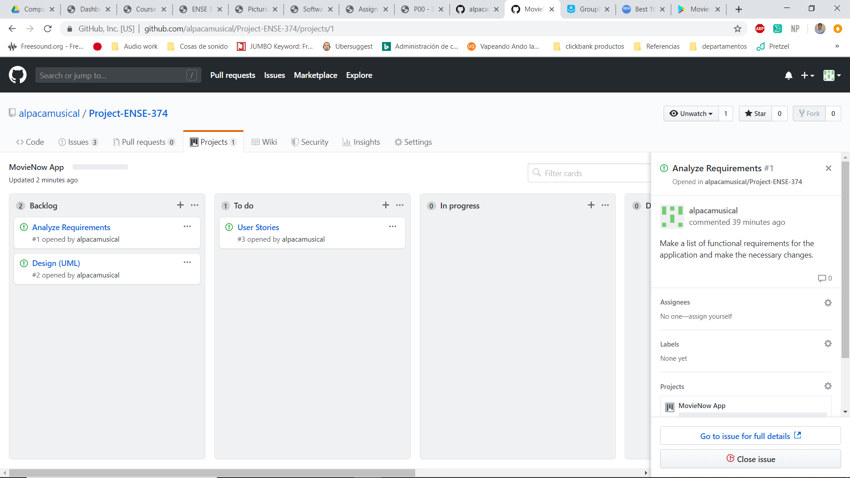
Initial Kanban

Slide 7
OUR GitHub
It will work with three different branches.
For now, it only has milestone and user stories documentation.

Slide 8
Misc.
Add other insights if you like but remember, your group’s report-out must be kept within 5 minutes

Slide 9
Group reflection
How did you feel about this milestone? What did you like about it? What did you dislike?
We felt that this milestone was a good starting point. We liked that it forced us to get the ball moving on the project, as usually group projects are all last minute. We disliked that some of the terminology was vague and required additional time to interpret.
What did you learn about yourself as you collaborated and worked through this milestone?
We learned that it is important to work as a team and set tasks for members to complete. We also learned how important it is to budget time according to deadlines.
How will you use what you have learned going forward?
We will use it to start working on the project when we have more time left before deadlines.
What “stuff & things” related to this milestone would you want help with?
Perhaps a clarification on some of the system requirements/ functional requirements section.

